Slide 1
Training Presentation
Session 2019-20
Student Management System
Training From:
Grass Solution Pvt. Ltd.
Submitted By:
Kaushal Kishor Agrawal

Slide 2
Node.js
Technologies are we used
Node.js is a server-side platform built on Google Chrome's JavaScript Engine (V8 Engine). Node.js was developed by Ryan Dahl in 2009.
Node.js is an open source, cross-platform runtime environment for developing server-side and networking applications.
Node.js applications are written in JavaScript, and can be run within the Node.js runtime on OS X, Microsoft Windows, and Linux.
Angular Framework
Angular is a very powerful JavaScript Framework. It is used in Single Page Application (SPA) projects.
It extends HTML DOM with additional attributes and makes it more responsive to user actions.
Angular is open source, completely free, and used by thousands of developers around the world.

Slide 3
Express.js
Express is a minimal and flexible Node.js web application framework that provides a robust set of features to develop web and mobile applications.
It facilitates the rapid development of Node based Web applications.
MongoDB
MongoDB is an open-source document database and leading No SQL database. MongoDB is written in C++.
This tutorial will give you great understanding on MongoDB concepts needed to create and deploy a highly scalable and performance-oriented database.

Slide 4
Front-End & Back-End Tools
Front-End Tool:-
Visual Studio Code - In which toy can build, develop, create and debug your applications is called Front-End tool.
Back-End Tool:-
MongoDB - It is a powerful relational database management system that offer a large feature set.

Slide 5
Introduction
Student management system is an environment where all the process of the student in the institution is managed.
It is done through the automated computerized method. Conventionally this system is done using papers, file and binders.
This system saves the time of the student and of the administrator.
It includes process like registration of the student’s details, assigning the department based on their course and maintenance of the record.

Slide 6
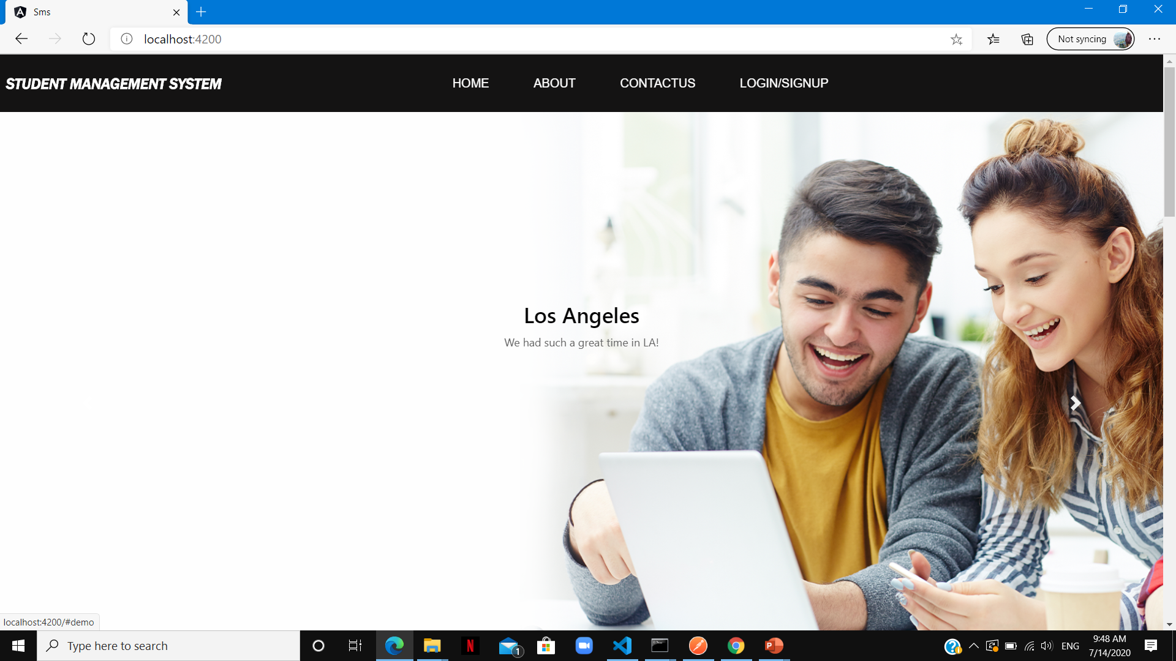
Home Page

Slide 7
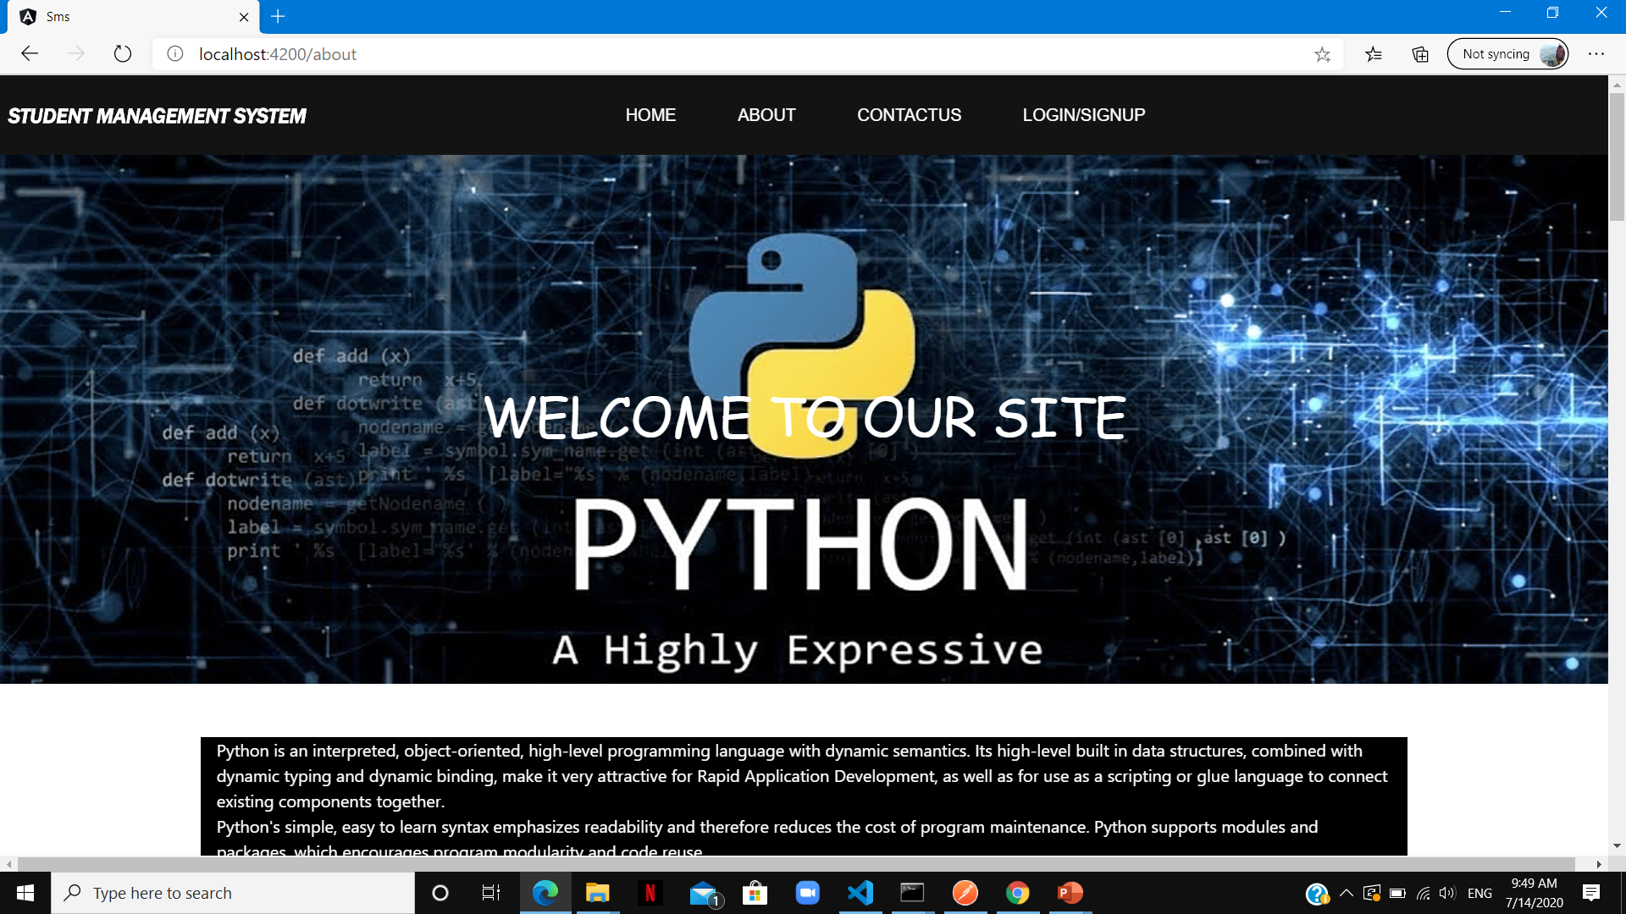
About Us

Slide 8
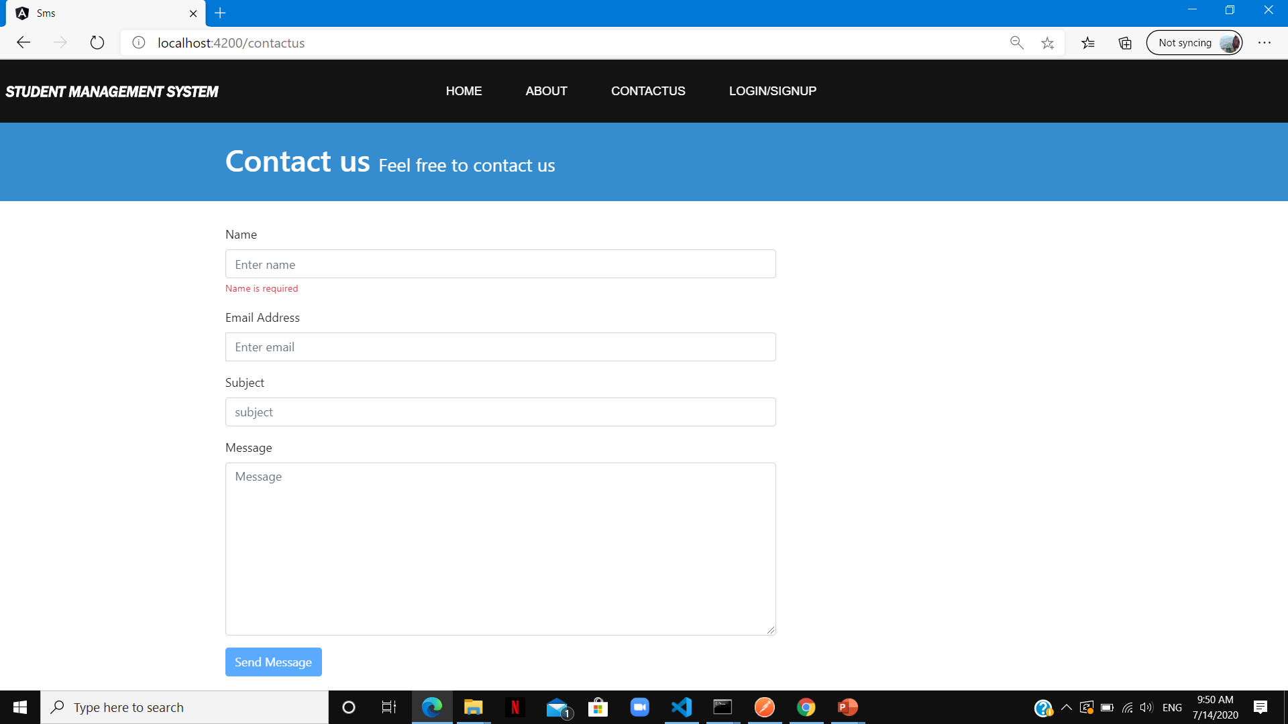
CONTACT US

Slide 9
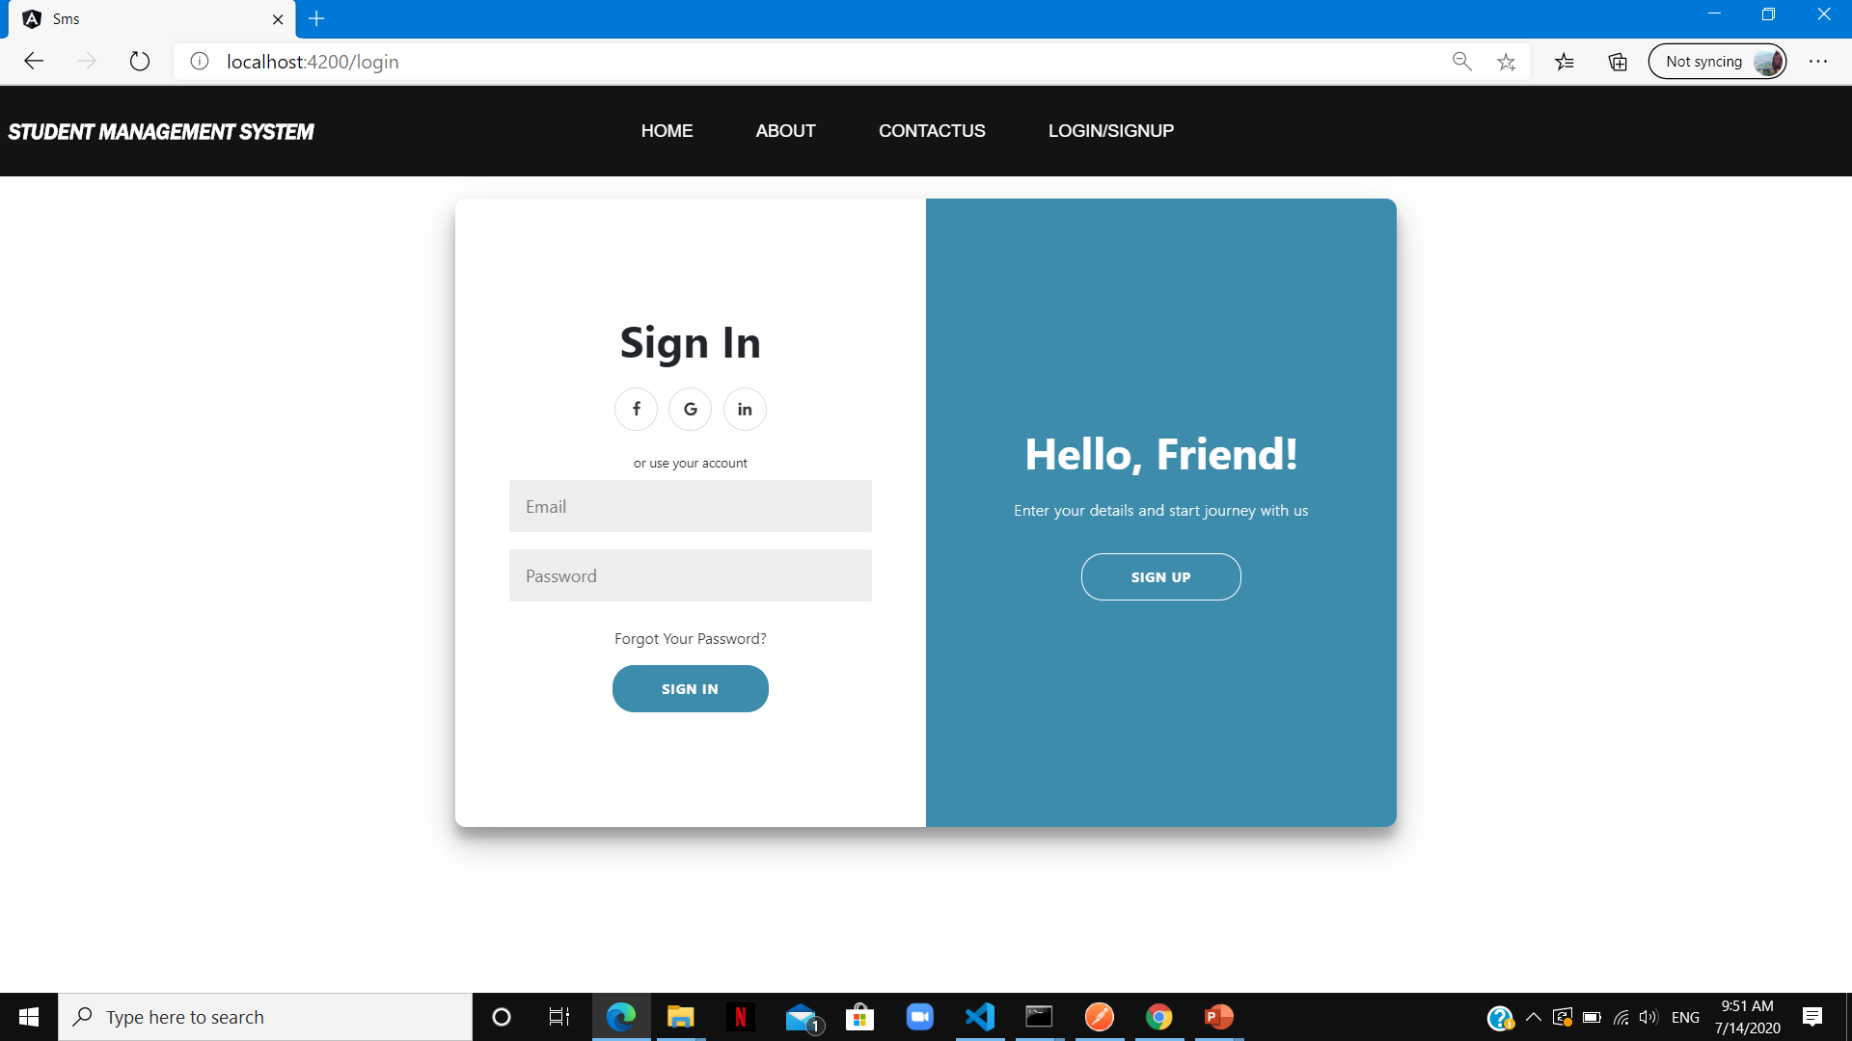
LOGIN page

Slide 10
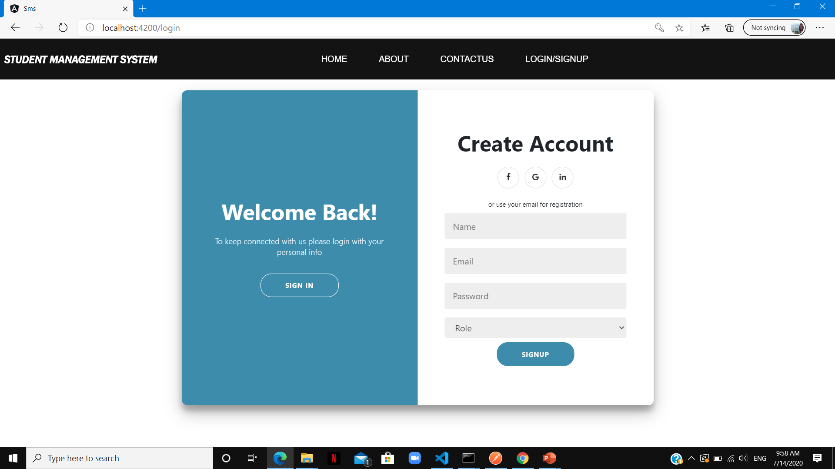
Signup page

Slide 11
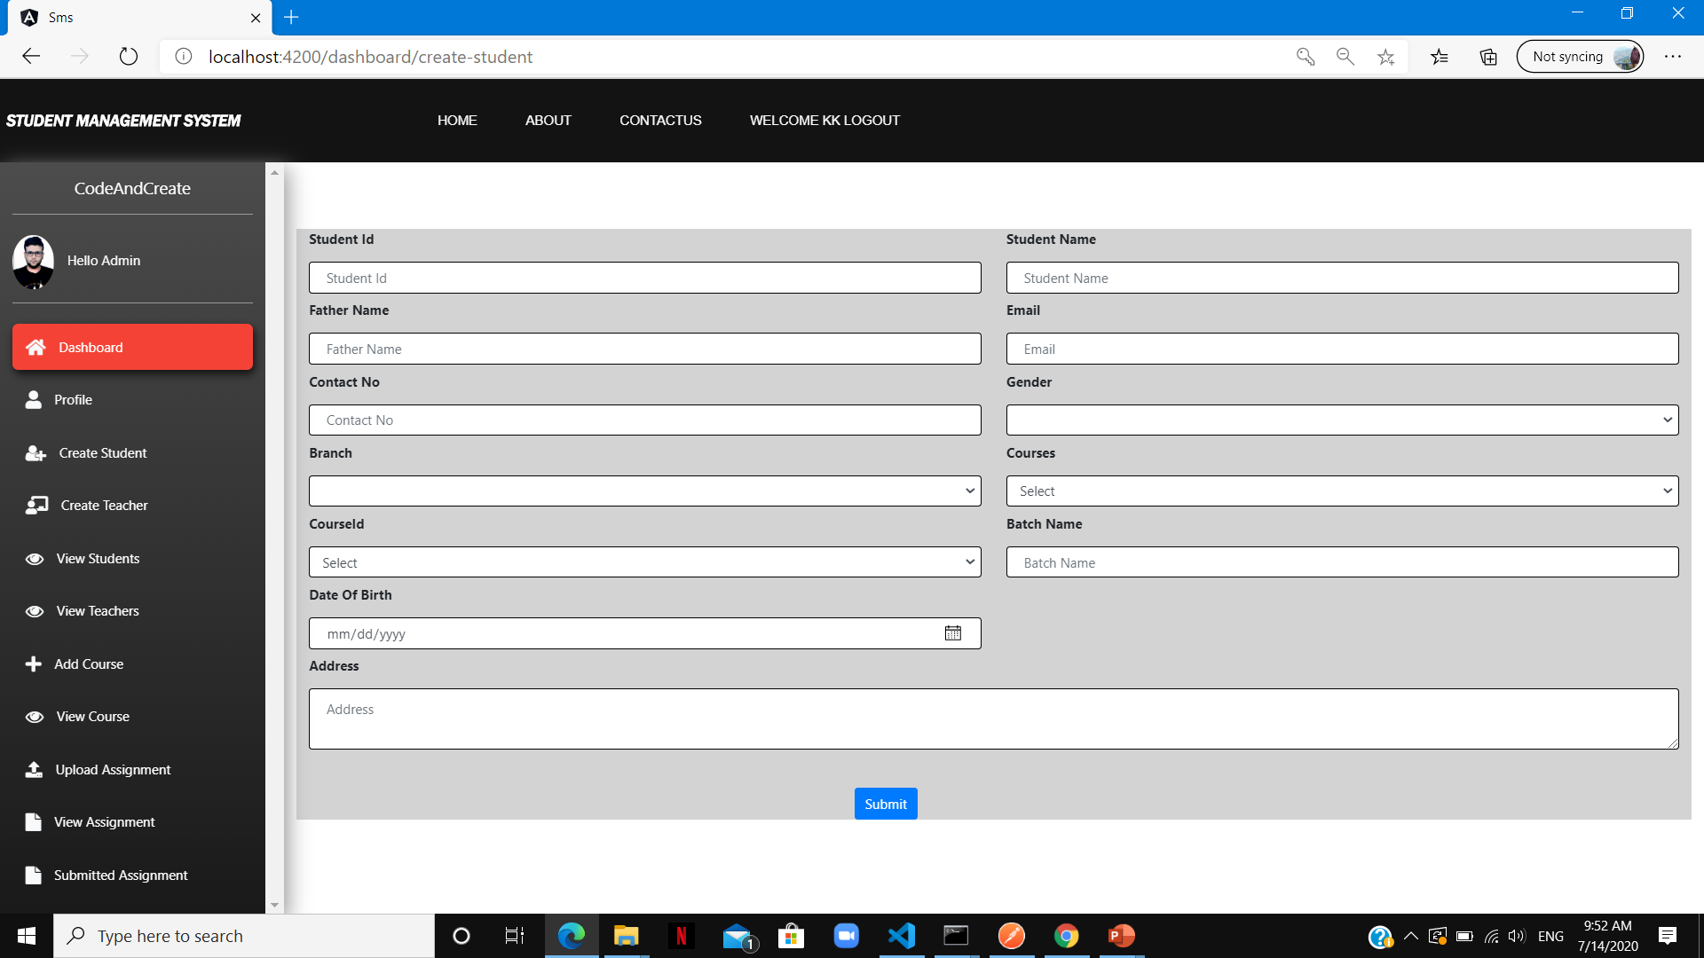
Admin dashboard
Continue…

Slide 12
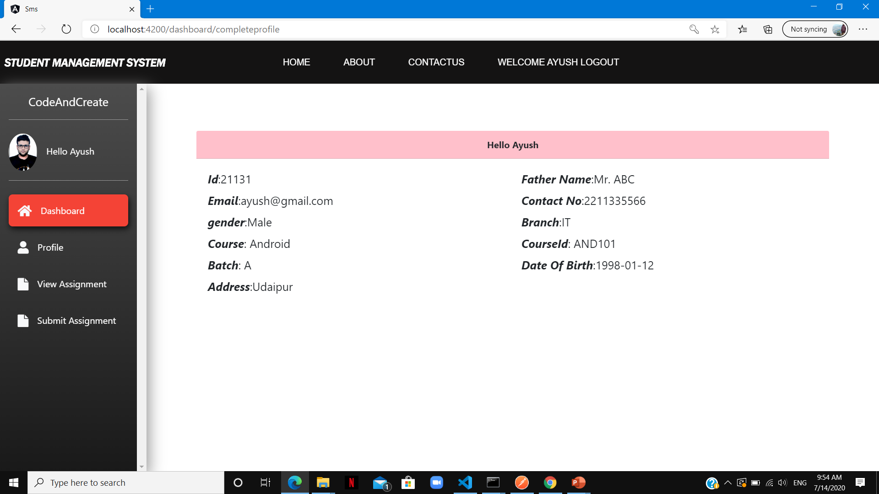
Student dashboard

Slide 13
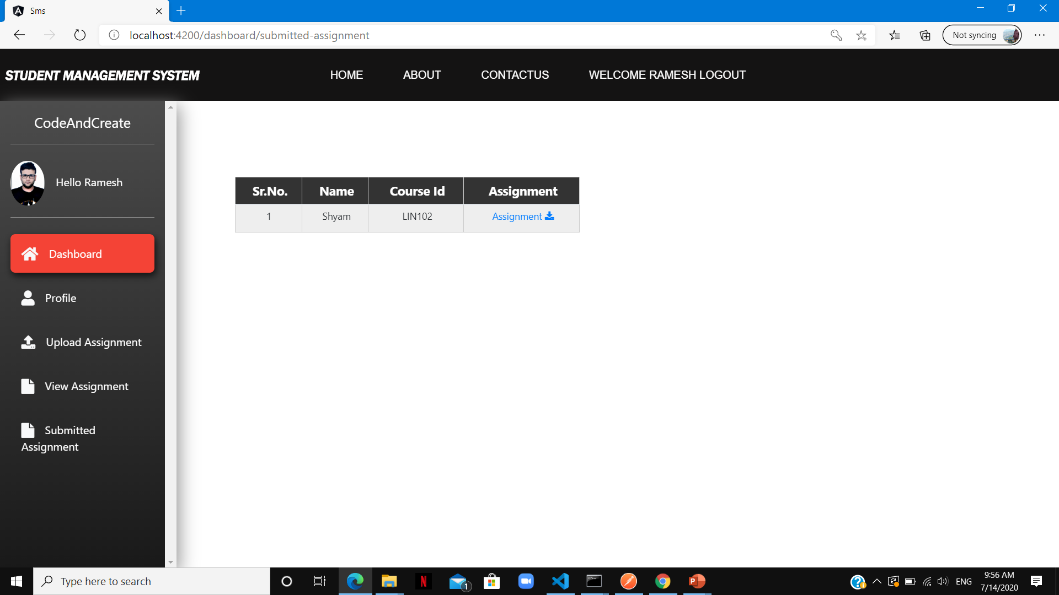
Teacher deshboard

Slide 14
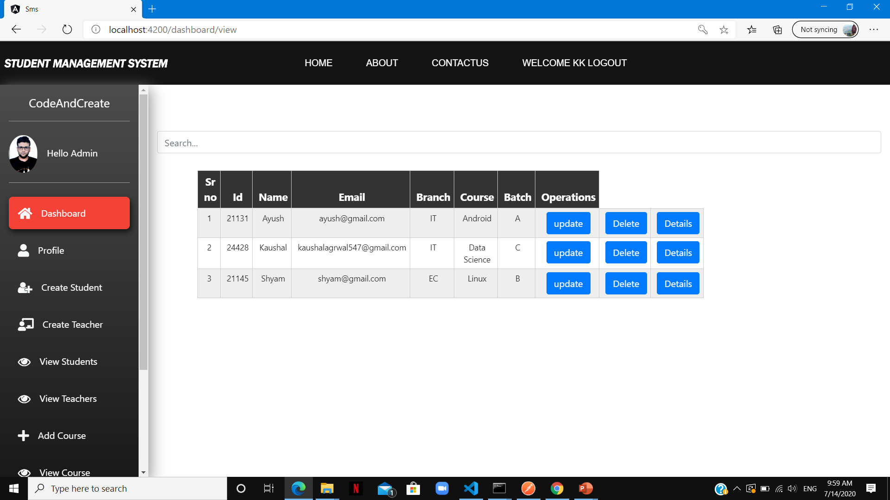
List of students

Slide 15
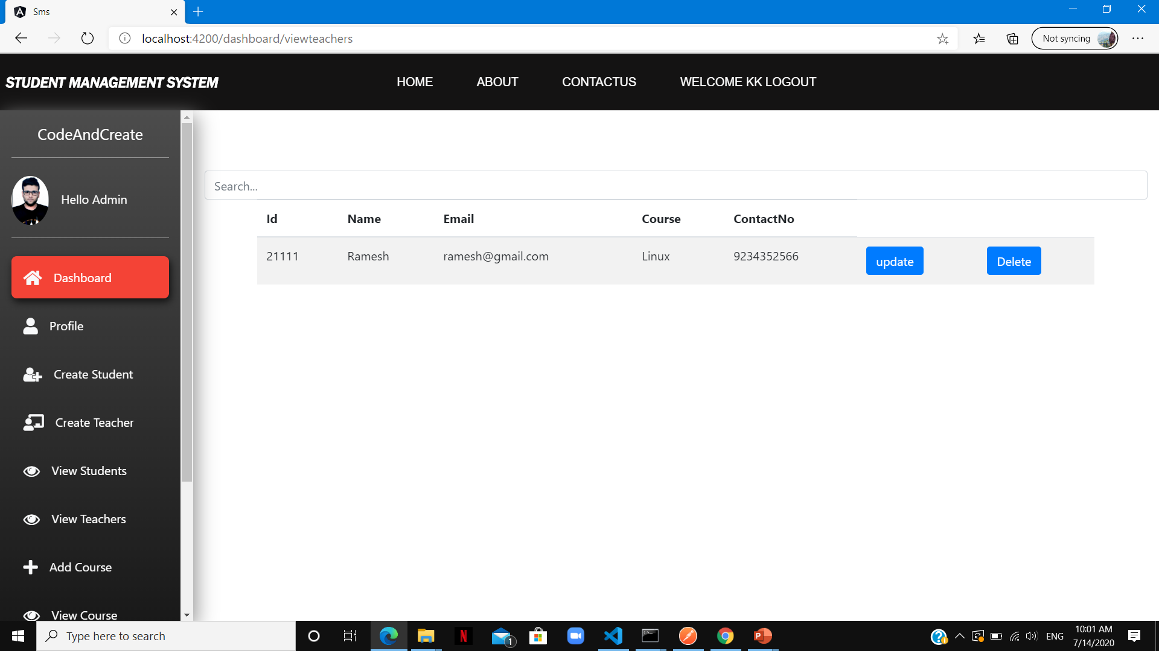
List of teachers

Slide 16
Thank You !!

